Slide 1


Investment Opportunities in Lesotho

Slide 2
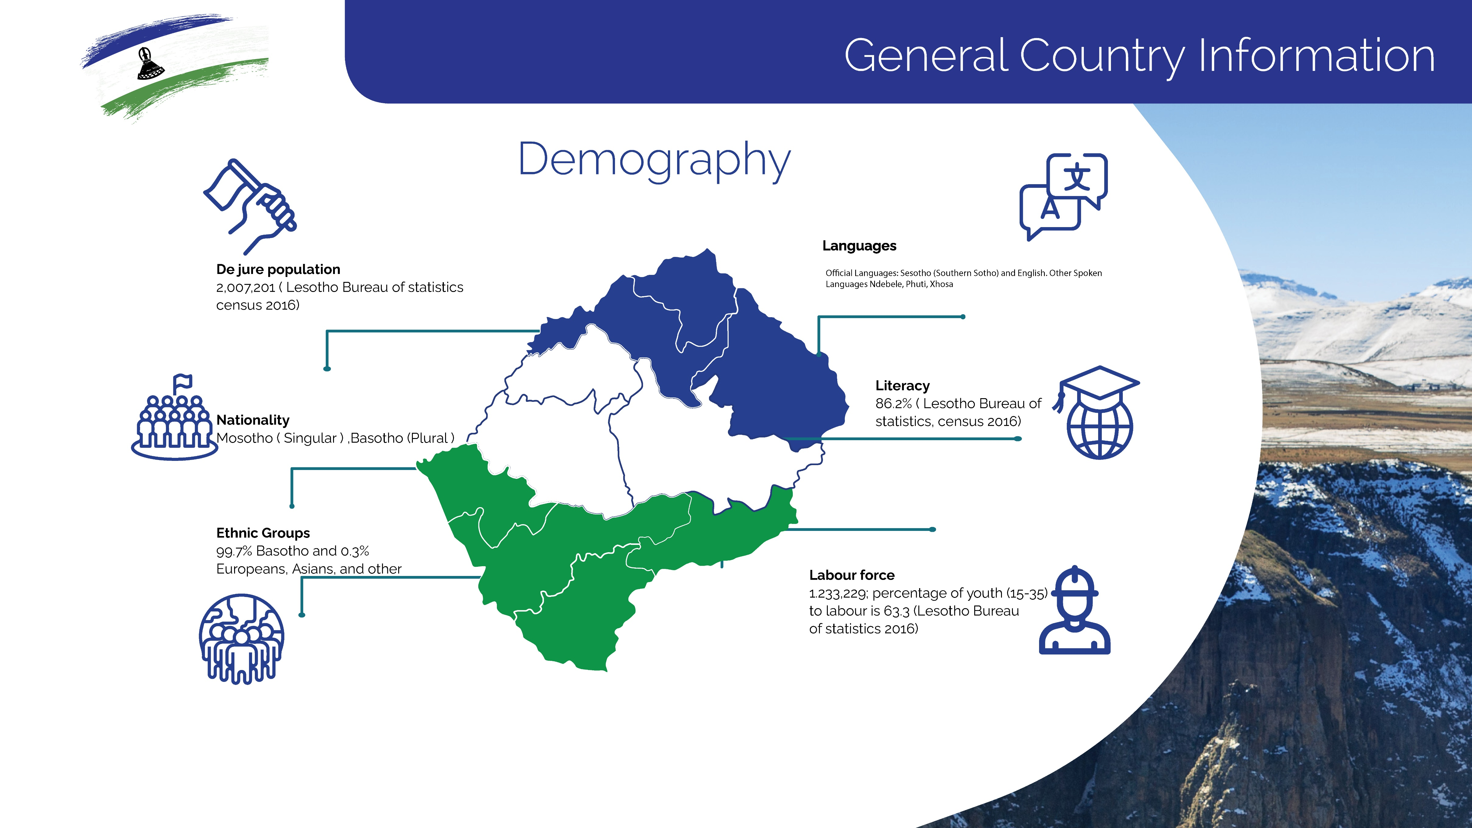
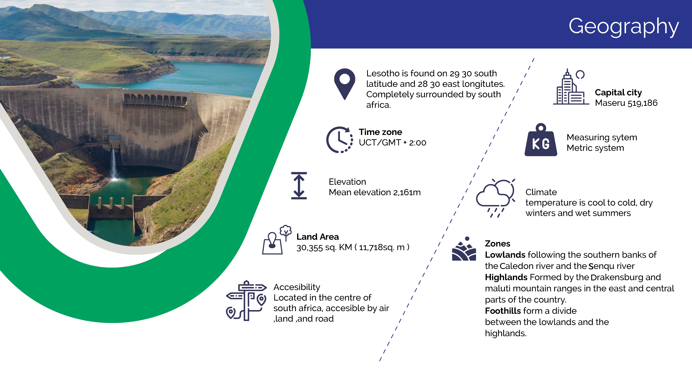
UNCDF First Annual Investment Forum:
Capital Pathways for Frontier Economies
September 22, 2022
LESOTHO

Slide 3
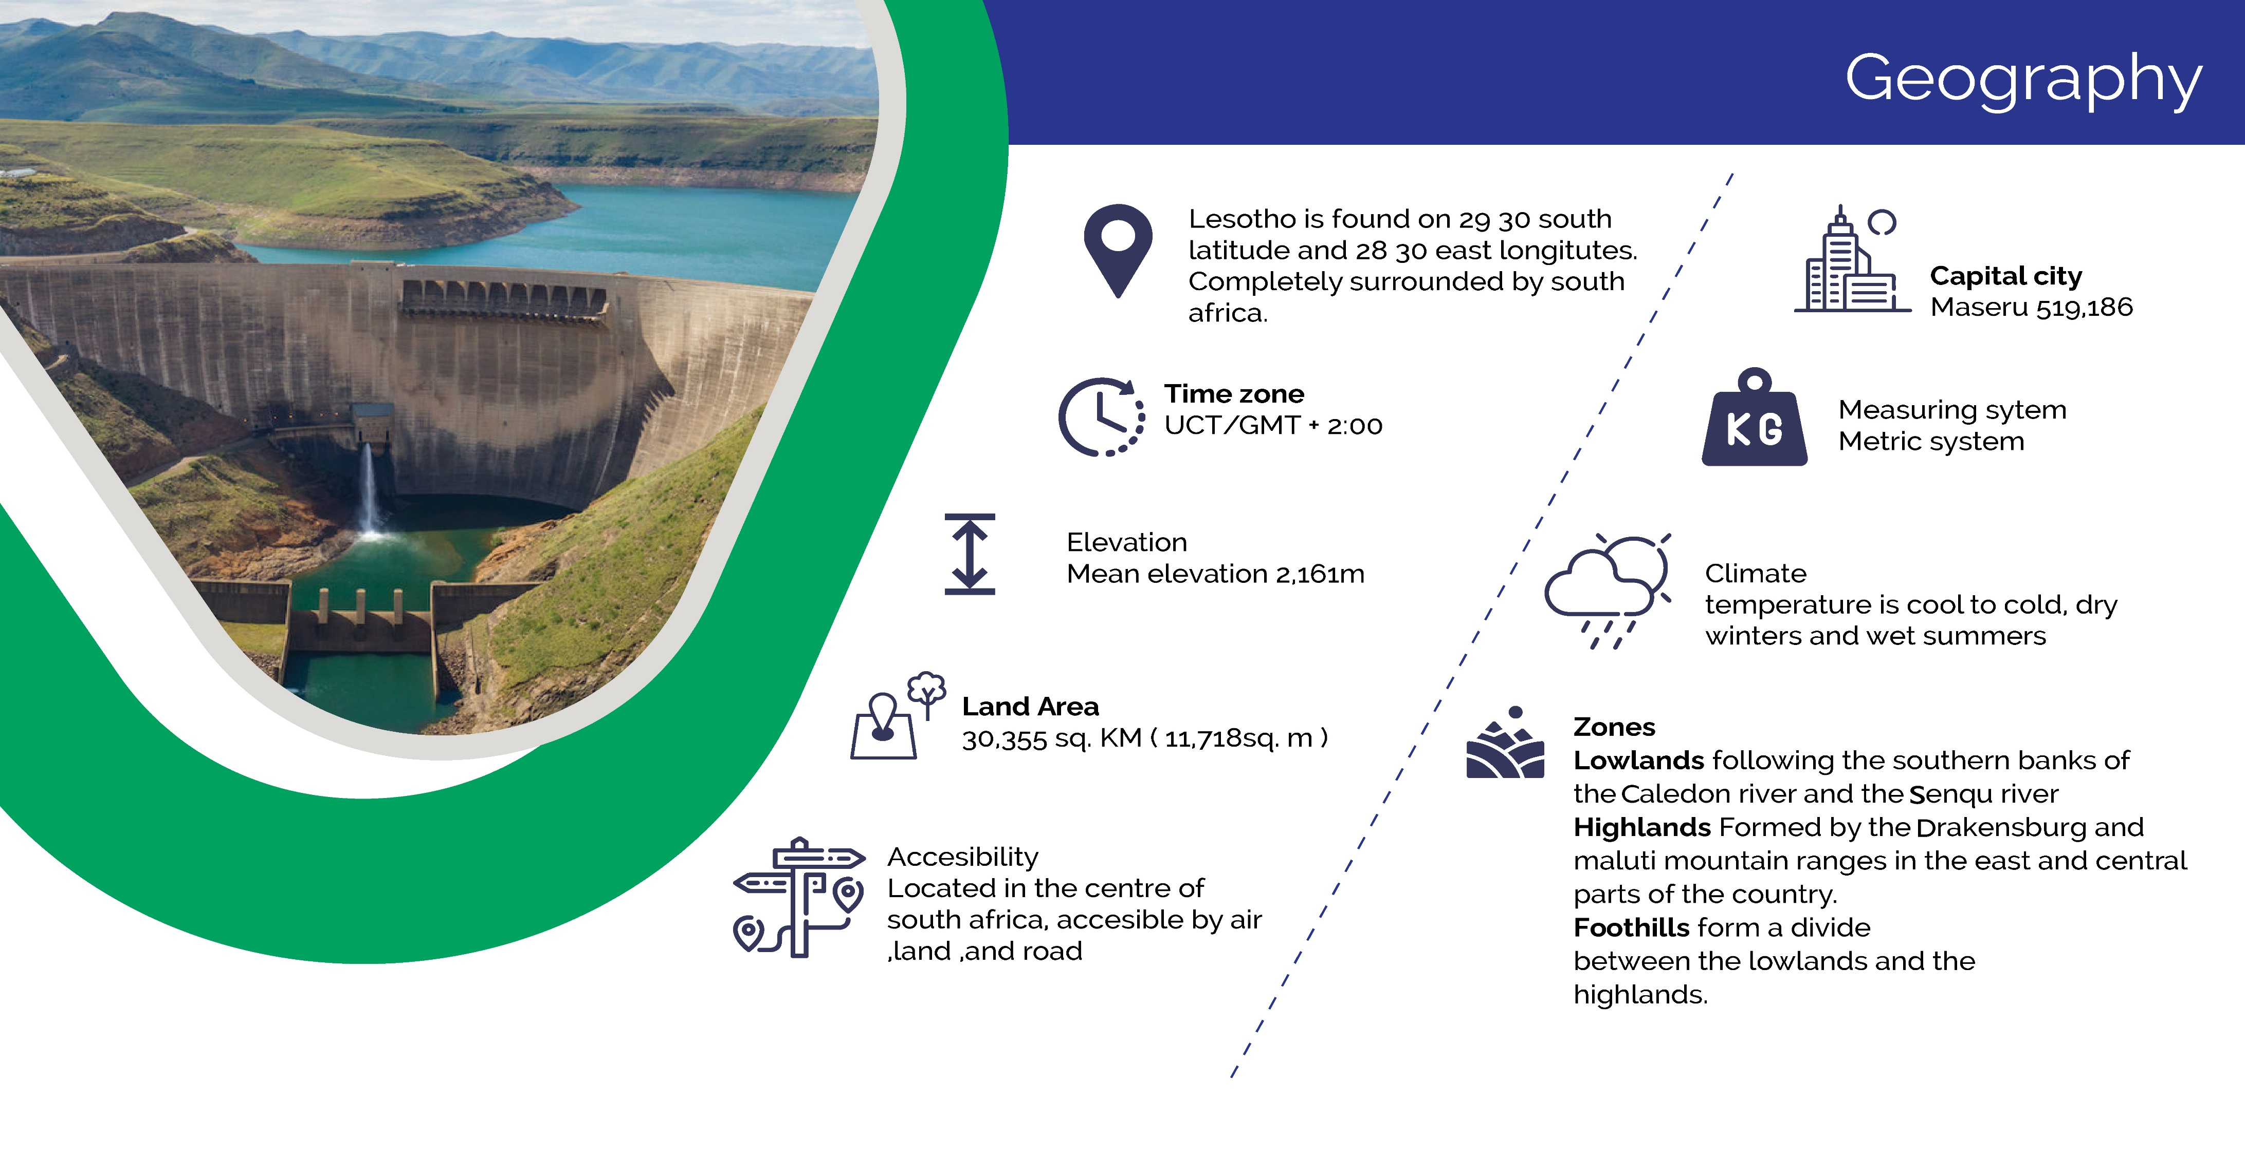

Slide 4
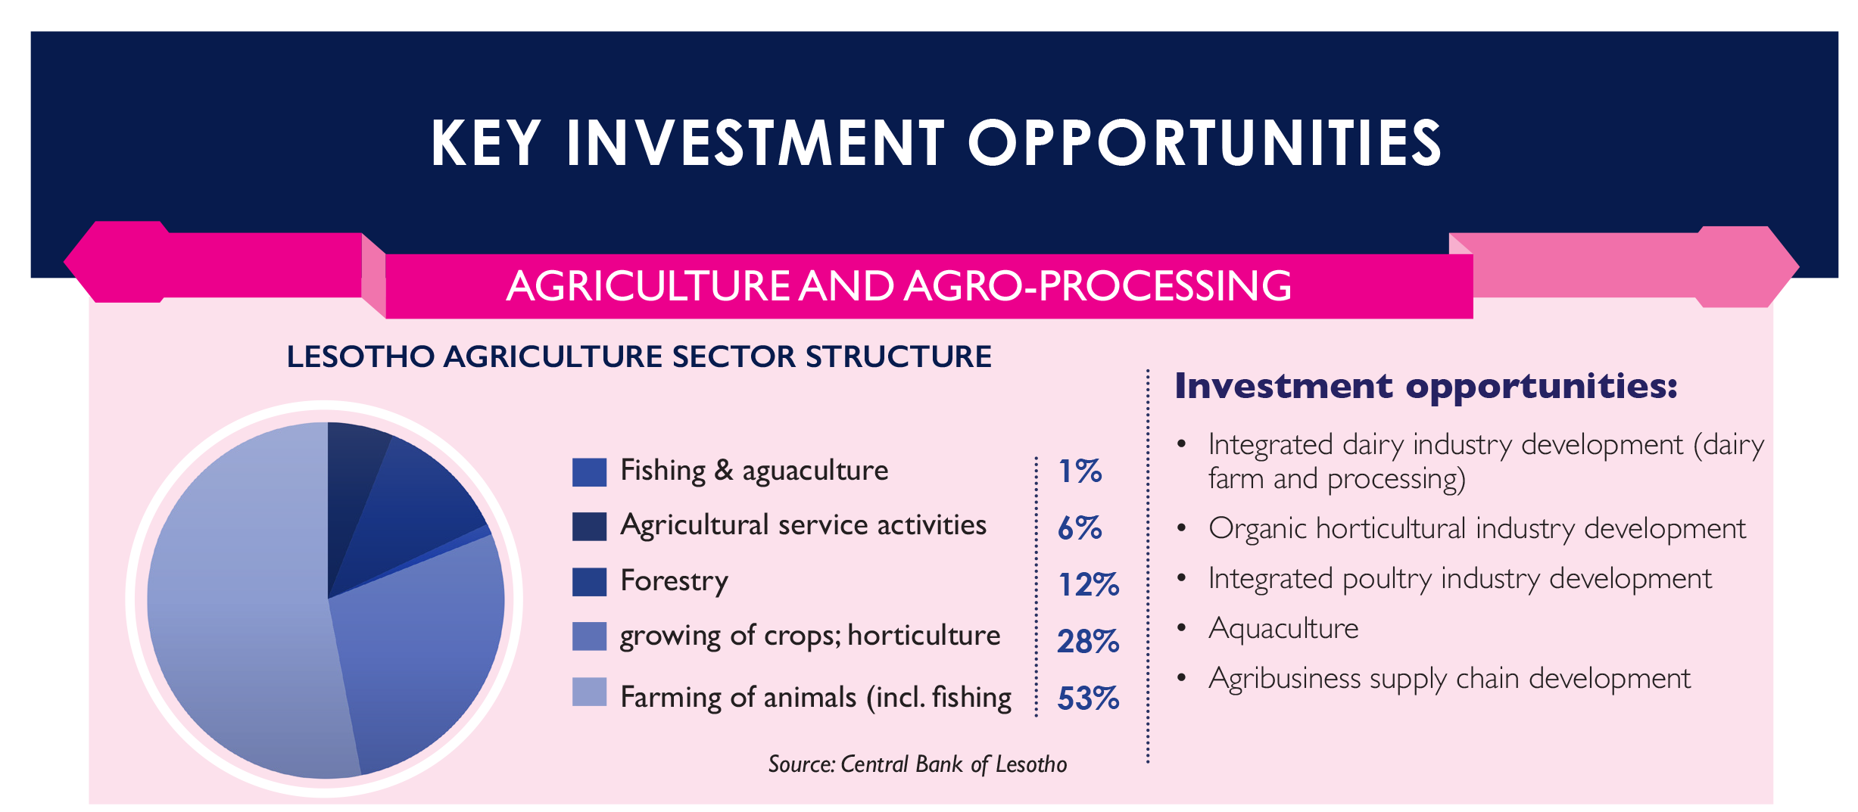
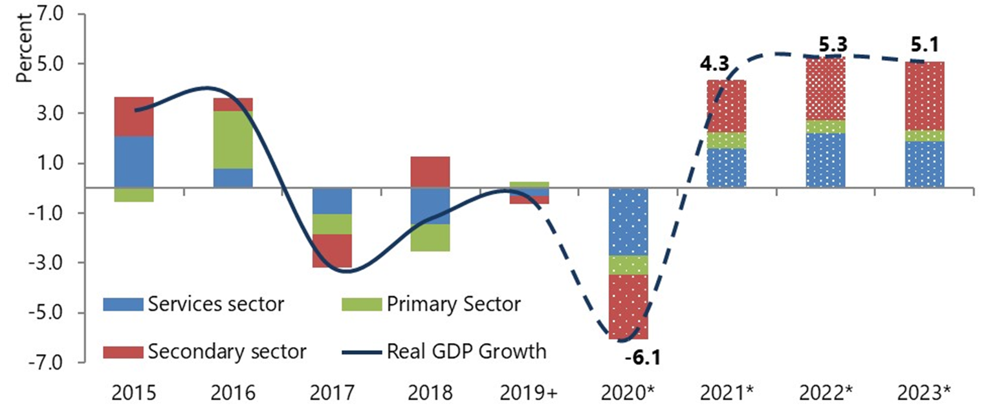
ECONOMIC INDICATORS IN LESOTHO
The domestic economy was projected to recover gradually and grow by 4.3 per cent in 2021 and picking up further to an average growth of 5.2 per cent over the period 2022 – 2023, with the level of output barely reaching the pre-pandemic level in 2022.
Notes:
Ranked 104 in world. 100 in world in 2017

Slide 5
Lesotho’s Trade with the World
Lesotho’s Top 10 Imports from World in 2020
Lesotho Top 10 Exports to the World in 2020
Cereals 3%
Automotive compnents 0.45%
Fish (trout) 0.57%
Fuel G petroleum products 9%
Footwear 0.82% Electrical appliances (TVs, etc) 1.50%
Milled products 2.06%
Diamonds G precios stones 32.73%
Optical G medical equipment 4%
Cotton 2.61%
Pharmaceutical products 4%
Electrical components 4.08%
Wool G Mohair (raw) 5.14%
Cotton 4%
Textiles G garments 12%
Milling products 4%
Fish G seafood 5%
Machinery G accessories 11%
Automotive components 5%
Textiles G Garments 46.43%

Slide 6
LESOTHO’S MAJOR TRADING PARTNERS

Slide 7
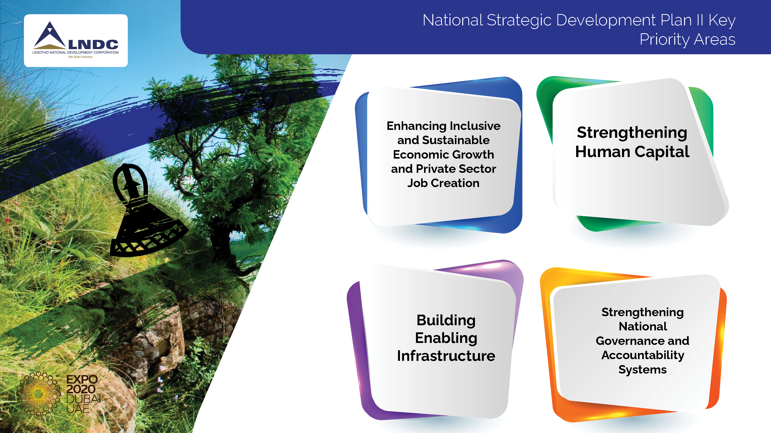
“Rising to prosperity!”

Slide 8

“we are a stable nation”
Why Invest In Lesotho
1
2
A free enterprise and free market economic system, which forms the basis for sustained development and growth
A stable and investor friendly macro economy environment
Labour force that is 62.1% of the population which is highly literate
Competitive wage rates
Companies qualify for 125% Tax rebate on training and skills development

Slide 9
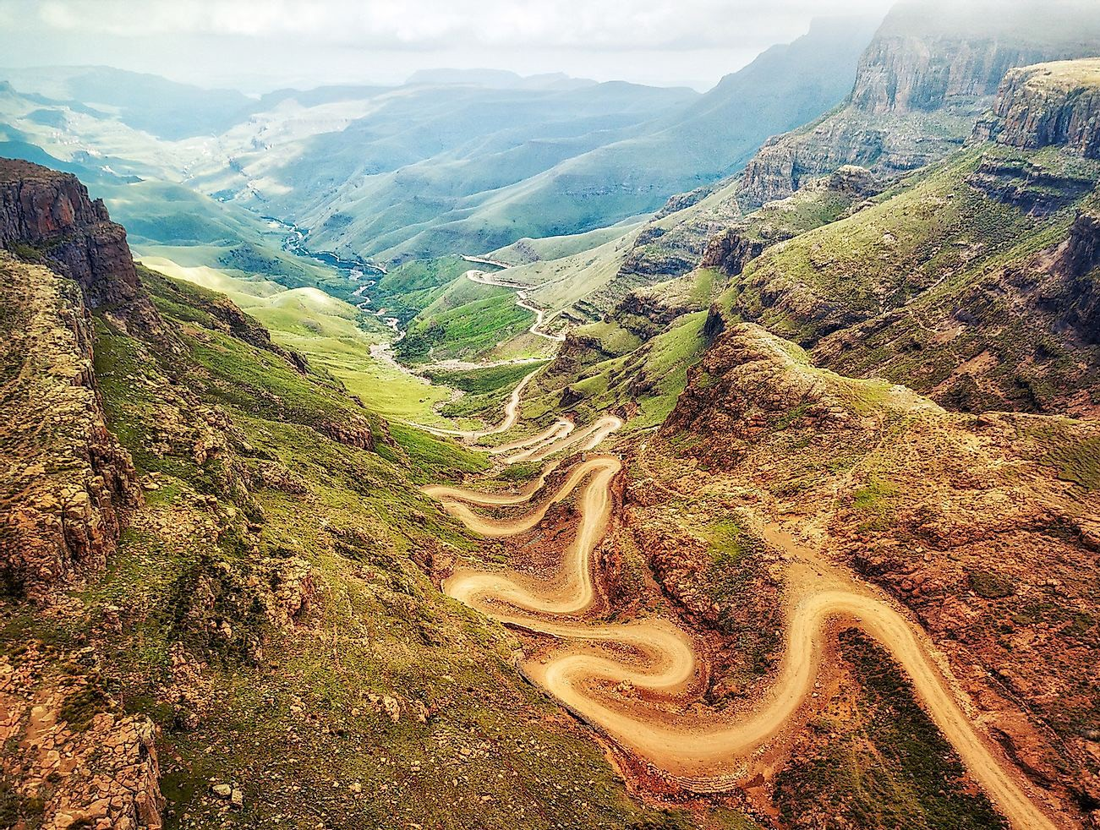

















Why Invest In Lesotho
Research and development ( R G D ) expenses are deductable provided they are incurred on production income subject to tax
15% withholding tax on payments made
in respect of external management / technical fees, interest and royalties related to manufacturing income

Slide 10
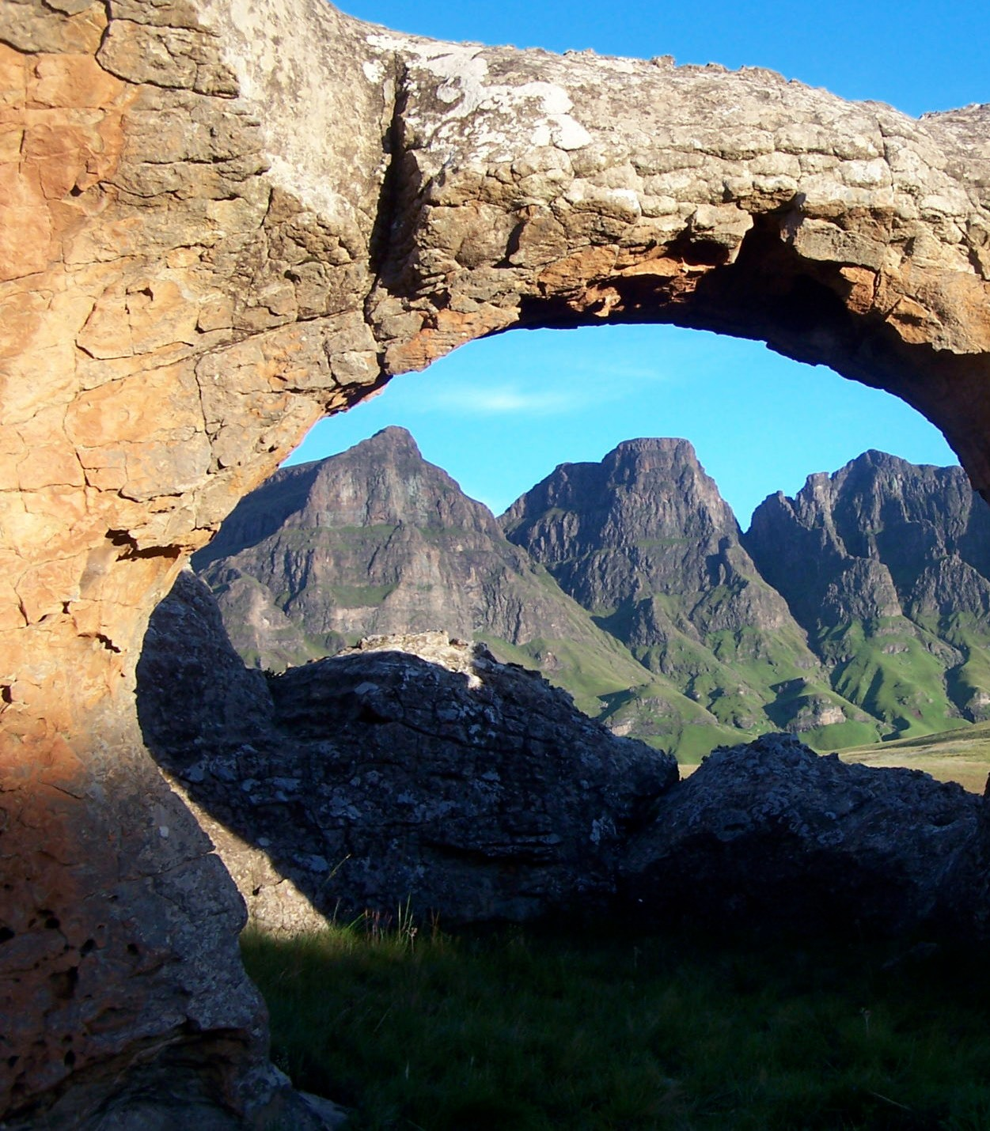

Why Invest In Lesotho
10% withholding tax rate on service contracts with non-residents
No withholding tax on dividends distributed from manufacturing income by resident companies to non-residents shareholders.
25% withholding tax in dividends distributed, from other incomes by resident companies to non-resident companies

Slide 11
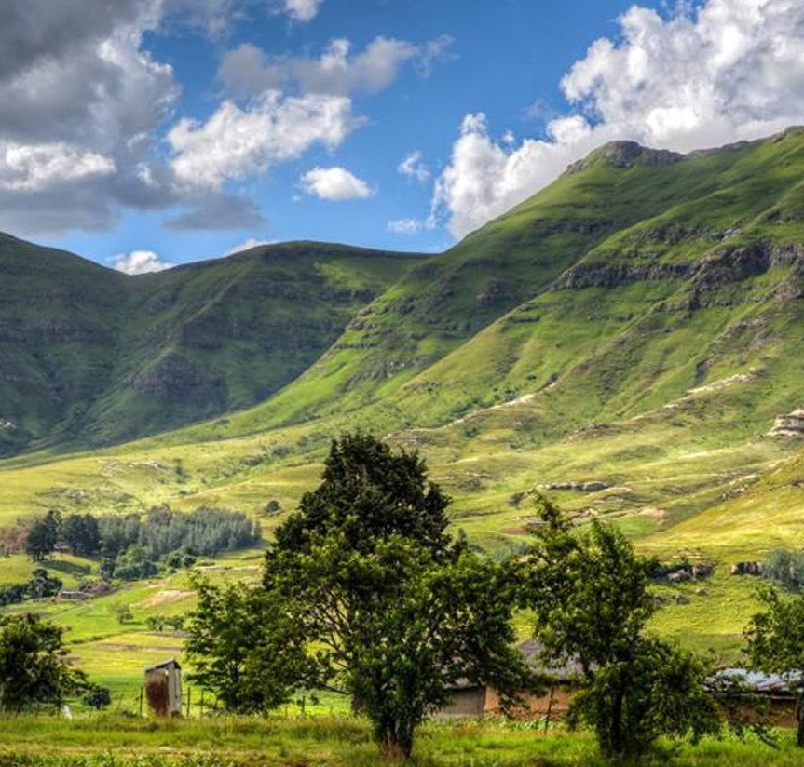












Why Invest In Lesotho
15% value added tax ( VAT ) rate
( common with south africa ) on goods and services sold in Lesottho and 0% VAT on direct exports.
100% depreciation allowances on investments in mining equipment

Slide 12

Why Invest In Lesotho
Infrastructure:
The LNDC provides serviced industrial land and industrial buildings for manufacturing and processing industries. The industrial parks are located in close proximity of labour pools, commercial borders and major transport and trade nodes in southern Africa.
Government Support:
The Government of Lesotho provides support to industrial development and continually develops and implements programmes and reforms that ensure the ease of doing business.

Slide 13
Manufacturing Investment Opportunities
Projects | Value Proposition | Total Investment | Return | NPV | Export Markets Served
Automotive Components | A cost competitive location for automotive component suppliers targeting South African Original Equipment Manufacturers (OEMs) South Africa’s expected output is 1.4 million vehicles per annum by 2035 | USD 5.5 million | IRR=88% Payback= 3.17 years Profitability Index=10.84 | USD 53.6 million | RSA, EU, USA 900+ million consumers
Textiles G Garments | A regional global textiles and garments industry. Aims at higher-value added export products Key strength is an experienced, productive, and competitive labour force | USD 480,000 | IRR=86.56% Payback=3.25 years Profitability Index = 11 | USD 5.8 million | USA, RSA, EU

Slide 14
Manufacturing Investment Opportunities
Projects | Value Proposition | Total Investment | Return | NPV | Export Markets Served
Knit/Woven Fabric Mill | Targeting Knitted/woven fabric mills for integration with growing textiles production and export markets 1 woven fabric mill already exists and utilizes 100% African sourced cotton LNDCi is ready provide serviced land and infrastructure Over 200,000m2 serviced land available for development | USD 13 million | IRR=19.76% Payback=6.90 years Profitability Index=2 | USD 6.8 million | USA, RSA, EU
Electrical Appliances | In 2017 USD 59m of TV sets, sound recorders and reproducers and related accessories was exported Objective is to diversify the product base and ramp up production levels | USD 1 million | IRR=18.12% Payback=8.89 years Profitability Index=2 | USD 605,000 | SACU

Slide 15
Manufacturing Investment Opportunities
Projects | Value Proposition | Total Investment | Return | NPV | Export Markets Served
Electrical Components | A significant player on electrical components manufacturing and export A location with production cost advantage over its competitors Key products include switches, relays, fuses, surge suppressors, plugs, sockets, lamp-holders, etc | USD 250,000 | IRR=45.43% Payback=4.90 years Profitability Index=5 | USD 1 million | China, UAE, EU
Footwear | Annual production capacity of over 7.2 million pairs of shoes per year Diversification with high value footwear | USD 2 million | IRR=13.21% Payback=10.29 years Profitability Index=1 | USD 605,000 | SACU, USA, Gulf

Slide 16

Agriculture & Agro-processing Investment Opportunities
Projects | Value Proposition | Total Investment | Return | NPV | Export Markets Served
Medicinal Cannabis | Exceptional natural – being the highest country – and legal environment for medicinal cannabis industry Drugs of Abuse (Cannabis) Regulations in 2008 The first African country to issue licenses in 2017 1 company has acquired European GMP certification | USD 24 million | IRR=57.81% Payback= 4.05 years Profitability Index=5 | USD 84.9 million | USA, EU, China, Japan
Hemp | Cultivating and processing Hemp (Cannabis sativa) Hemp is versatile with new and exciting uses in foods and beverages, pharmaceuticals, cosmetics, and lifestyle industries In 2019 major hemp importers were Germany, Spain, Czechia, Australia and Poland. | USD 1.2 million | IRR=15.36%% Payback=9.16 years Profitability Index = 1 | USD 460,000 | EU

Slide 17
Agriculture & Agro-processing Investment Opportunities
Projects | Value Proposition | Total Investment | Return | NPV | Export Markets Served
Game Birds (duck, quail, geese, guinea fowl) | Rising domestic and global demand for game bird meat is an incentive to invest in farming and processing Competitive tax and labour offer and tariff-free access to major markets Cold climate ideal for disease control and to meat organic standards | USD 1.9 million | IRR=88% Payback= 3.17 years Profitability Index=10.84 | USD 250,000 | SACU, USA, EU
Organic Vegetables | A favourable climate, low labour costs and access to major global markets Rising demand for organic vegetables | USD 1.3 million | IRR=36.50% Payback=5.57 years Profitability Index=3 | USD 2 million | SACU, EU, USA

Slide 18
Agriculture & Agro-processing Investment Opportunities
Projects | Value Proposition | Total Investment | Return | NPV | Export Markets Served
Cereals Production | Adding value to grains (maize, oats, wheat, sorghum, soya beans, sunflower) by processing them into cereals There is significant production scale of grains in Lesotho and the SADC countries for inputs South African breakfast cereal market alone is estimated at USD 290.6 million annually. | USD 1.1 million | IRR=34.4% Payback=5.04 years Profitability Index=3 | USD 1.7 million | SACU, USA, EU
Herbs, Spices G Aromatic Plants | There is a rising global demand for herbs, aromatic plants and spices High altitude and cool-cold climate favour high-quality organic varieties e.g. saffron, chili, Paprika, Geranium, Rosemary, etc Endowed with unique high-value varieties with strong health benefits e.g. Stingnettel, wormwood, wild mint | USD 297,000 | IRR=15.11% Payback=9.04 years Profitability Index = 1 | USD 96,600 | China, Japan, SACU, EU, USA

Slide 19
Agriculture & Agro-processing Investment Opportunities
Projects | Value Proposition | Total Investment | Return | NPV | Export Markets Served
Deciduous Fruits Production G Processing | Favourable altitude, climate and soils for growing deciduous fruits 5, 500 hectares land is suitable for growing deciduous fruits 34 hectares Pilot farms have yielded greatly and proven that harvests are 2-3 weeks earlier than South Africa Opportunity commercialize with more production, machinery, processing and cold chain management Joint venture with communities (land owners) and a technical partner. | USD 8.6 million for each 120 hectares 500 hectares expansion at USD 60 million | Annual revenue (full yield): USD 3.4 million IRR=39.2% | USD 3.4 million | SACU, Africa USA, EU, UK

Slide 20
Technology & Innovation Investment Opportunities
Projects | Value Proposition | Total Investment | Return | NPV | Markets Served
Call centres | A pool of English-speaking graduates and proximity to South Africa simplify setting up and managing business operations Good international connectivity via three main submarine cables A globally competitive cost per call centre seat per hour | USD 1.2 million | IRR=24.63% Payback=6.44 years Profitability Index=2 | USD 940,000 * discounted at 10% | South Africa, Middle East, Europe, N America, Domestic
Knowledge Process Outsourcing (KPO) G Business Process Outsourcing (BPO) | Attractive host for BPO and KPO businesses A steady supply of well-educated graduates Skilled and semi-skilled workers readily available to meet immediate needs for developed over the short to medium term. Support and incentives available to assist in training and skills development. | USD 1.6 million | IRR=31.45% Payback=5.88 years Profitability Index = 3 | USD 2.6 million | South Africa, Middle East, Europe, N America, Domestic

Slide 21
Technology & Innovation Investment Opportunities
Projects | Value Proposition | Total Investment | Return | NPV | Markets Served
Fashion (Textile G Garments) Design Hub | An unique opportunity to drive innovation and growth in a niche part of the global textiles and garments sector A unique culture of design and use of African and sustainably produced natural materials and indigenous African designs and art Leverage existing burgeoning and internationally competitive garments and textiles manufacturing industry | USD 30,000 | IRR=66.12% Payback=2.82 years Profitability Index=5 | USD 82,000 | South Africa, Middle East, Europe, N America, Domestic
Business precinct *SDGs 8, 9, 10 and 11 | A PPP opportunity for a mixed-use smart business precinct in Maseru Customers include local and multinational companies with business operations in Lesotho 170,000 m2 (17 hectares) land is available | USD 1.2 million for preproduction costs * Total investment will depend on designs | Not available | Not available | Domestic and multinational businesses

Slide 22
Tourism & Hospitality Investment Opportunities
Projects | Value Proposition | Total Investment | Return | NPV | Markets Served
Mohale Resort | A tourism resort located near the Mohale Dam in the Lesotho Highlands Constructed during the dam construction and will bring improvements to buildings and support infrastructure Comprises of 107 single and double storey structures that range from single to four bedrooms | USD 1.6 million | IRR=33.43% Payback=5.04 years Profitability Index=2 | USD 2.3 million | South Africa, International, Domestic
Mohale Water Park | Opportunity for a water leisure park amid the superb scenery of the Lesotho Highlands with A water leisure park A cruise boat for the lake A community outdoor centre A fly-fishing lodge | USD 1 million upwards based on standard and lodge size |  | USD 1.8 million | South Africa, International, Domestic

Slide 23
Tourism & Hospitality Investment Opportunities
Projects | Value Proposition | Total Investment | Return | NPV | Markets Served
Semonkong Resort | A tourism development opportunity centred on nature, community and adventure tourism Semonkong is Sesotho for “Place of Smoke” 192-metre (630ft) high Maletsunyane Waterfalls (records tallest single-drop waterfall and worlds longest commercial abseil) Demonstrated tourism potential with Semonkong Lodge always fully booked. The lodge or chalets The proposed zipline A suspension foot bridge | USD 1 million upwards based on standard and lodge size | IRR=33.43%% Payback=5.04 years Profitability Index = 2 | USD 2.3 million | South Africa, International, Domestic

Slide 24
Infrastructure Development Investment Opportunities
Projects | Value Proposition | Total Investment
Mafeteng SEZ | Estimated area of 79 000.00 Hectares 80 kilometres South of Maseru 500km from the Port of Durban; the largest and busiest shipping facility in Sub-Saharan Africa, strategically located on the eastern coast of South Africa Targets agriculture and agro-processing, medicinal cannabis, pharmaceuticals, and manufacturing | Initial Estimated Project Preparation Cost at USD 580,000.00 Master Plan yet to be developed.
Belo Industrial Park Phase II | Located in the Botha Bothe district (NW) offers a total of 51 factories with a total space of 51,000m2 Phase I comprises 16 factories - target completion at April 2022 Phase II seeks to explore private investments for construction and management of 35 factory shells. Projected to create over 14,000 jobs at the completion of the 51 factories. | USD 55.5 million

Slide 25
Infrastructure Development Investment Opportunities
Projects | Value Proposition | Total Investment
Upgrading of Moshoeshoe I International Airport | BOT opportunity on increasing the handling capacity and improving the quality services at the Moshoeshoe I International Airport Built passenger and freight transport capacity effciently and safely in compliance with international Civil Aviation Standards Improvement and expansion of the airside infrastructure, the main runway, taxiways, apron, and the landside buildings and facilities Moshoeshoe 1 International Airport is at an elevation of 5,348 feet (1,630 m) above mean sea level. It has two asphalt paved runways, 04/22 measuring 3,200 by 45 metres. | USD 13.7million

Slide 26
Further information and contact details
Contact Details
Mrs. Puseletso Makhakhe General Manager-Investment &Trade Promotion Unit. makhakhe@lndc.org.ls
Email: ce@lndc.org.ls/info@lndc.org.ls Website: https://www.lndc.org.ls/
Tel: 266 22312012

Slide 27
Thank You!

